Slide 1
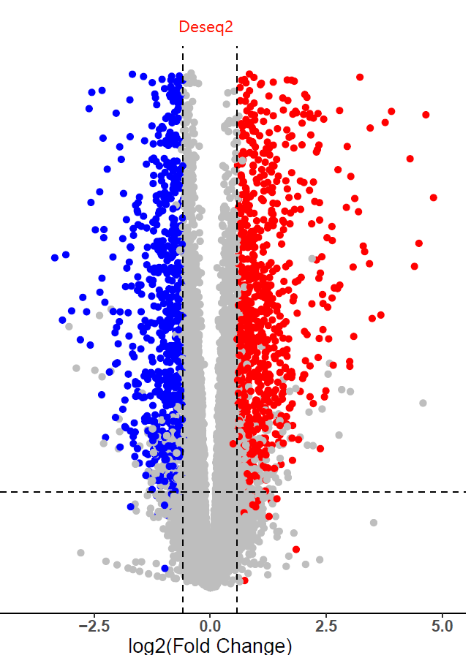
RNA-Seq Analysis
Part 2: Differential Expression Analysis
Eleni Maniati, PhD
Centre for Cancer Genomics and Data Science
Notes:
This title slide should be used directly (with the addition of your presentation title, your name and your centre).
Please do not add any additional logos to this slide.
If you would like to customise the image on the right-hand side of the slide, please use slide 2 which will allow you to add your own image.

Slide 2
What is Differential Expression Analysis
Differential expression analysis is used to identify differences in gene expression across two (or more) groups of samples (eg drug treated vs untreated) .
Many tools are available to perform this type of analysis.
In this practical we will use Bioconductor R package DEseq2.
We will also make graphical visualizations to help interpret our results.

Slide 3
Dataset
We will analyse a publicly available dataset that was generated here at BCI (https://www.ncbi.nlm.nih.gov/geo/query/acc.cgi?acc=GSE141630)
The study aimed to examine chemotherapy resistance in ovarian cancer cell lines
In this practical, we will use part of this data and compare chemotherapy resistant cells to chemotherapy sensitive cells. We will have 3 samples per group and two groups in total.
Our aim is to identify the differentially expressed genes in resistant versus sensitive cells

Slide 4
DE analysis workflow using DESeq2
Read counts matrix
Experimental design matrix
Create DESeq2Dataset object,filter out low count genes, run DESeq2
Count Normalisation
Transform counts (vst, rlog)
Unsupervised clustering
plot PCA, HCA
Fit GLM model
Get DESeq2 DE results
Check fit of dispersion estimates
Plot dispersion estimates
Save DE results tables into .txt/.csv files
Also save transformed counts into .txt/.csv
Graphical visualization of the DE results
MA plot, volcano, heatmap

Slide 5
1. Getting started with DESeq2
Available through Bioconductor
Provides a set of methods and functions to perform differential expression analysis.
The differential expression tests are based on negative binomial generalized linear models
Lets get started by downloading the package and loading it on R
if (!require("BiocManager", quietly = TRUE)) install.packages("BiocManager") BiocManager::install("DESeq2")
library(“DESeq2”)

Slide 6
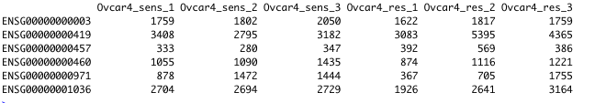
2. Input data – Read Counts
Input data for DESeq2 is raw, un-normalised read counts at gene or transcript level
I am providing you with the counts matrix which I have assembled from the individual gene abundance count tab files of each individual sample.
The the counts matrix contains the sequence read counts for all genes. The genes are in rows and the sample ids are in columns.
Lets load the counts matrix into R and have a look into it
rawCounts <- read.delim("counts.txt", header = T, row.names = 1)
rawCounts <- ceiling(rawCounts) #NOTE: expected_counts are floats, we need to convert them to integers for DESeq2
head(rawCounts)
genes
samples
IMPORTANT! In order to test for differential expression, we operate on raw counts

Slide 7
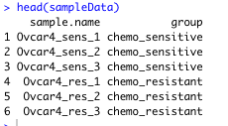
2. Input data – Sample Groups
We also need to provide the sample groups (as well as other sample information if available, for more complex experimental designs this would include clinical parameters)
sampleData <- read.delim("sampleGroups.txt", header = T)
head(sampleData)
IMPORTANT! The order of the sample names has to match the order of the columns in the rawCounts matrix

Slide 8
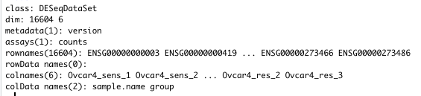
3. Create DESeq2 object
We create a DESeq2 object that contains counts and sample info. This object will be used for all downstream DE analysis
dds <- DESeqDataSetFromMatrix(countData = rawCounts,
colData = sampleData,
design = ~ group)

Slide 9
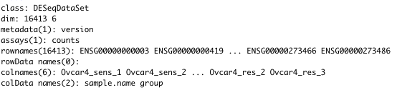
4. Filtering out low count genes
By removing rows in which there are very few reads, the memory size of the DESeq2 data object is reduced, and the speed of functions is increased
It also improves graphical visualizations
A popular filter in DESeq2 is to ensure at least X samples with a count of 10 or more, where X can be chosen as the sample size of the smallest group of samples
keep <- rowSums(counts(dds) >= 10) >= 3
dds <- dds[keep,]

Slide 10

5. Run DESeq algorithm
Now we need to run the DESeq algorithm in order to be able to run the next steps, we will talk in more detail about it a bit later on (in slide 16)
dds <- DESeq(dds)

Slide 11
5. Data normalisation
The total number of reads (library size) in each sample slightly varies. We need to take this into account to be able to accurately compare gene expression between samples. For this reason we need to normalize the data to library size.
There are many methods of data normalization e.g. DESeq2's median of ratios, CPM (counts per million), TPM (transcripts per kilobase million), RPKM/FPKM (reads/fragments per kilobase of exon per million reads/fragments mapped).
DESeq2's median of ratios = counts divided by sample-specific size factors determined by median ratio of gene counts relative to geometric mean per gene.
To extract the normalised counts from the DESeq2 object:
norm.counts <- counts(dds, normalized=TRUE)
write.csv(norm.counts, file="normalized_counts.txt", row.names=TRUE)
head(norm.counts)

Slide 12

5. Data transformation
IMPORTANT: In order to test for differential expression, DESeq2 operates on raw counts inside the Generalized Linear Model. However, for downstream analyses – e.g. for visualization or clustering – it is useful to work with transformed versions of the count data.
DESeq2 provides two methods for data transformation:
  variance stabilizing transformations (VST) which produces transformed data on the log₂ scale, normalized with respect to library size
  regularized logarithm (rlog), which incorporates a prior on the sample differences and produces transformed data on the log2 scale normalized with respect to other normalization factors.
vsd <- vst(dds, blind=FALSE)
head(assay(vsd),3)

Slide 13
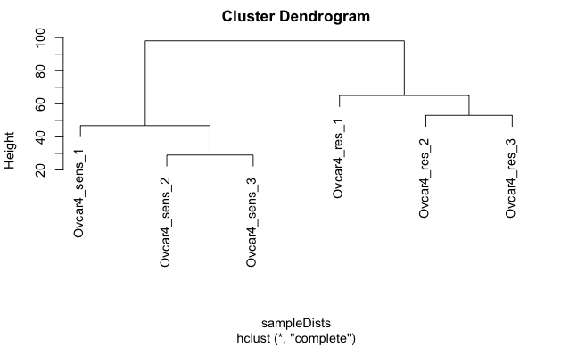
6. Unsupervised clustering – Hierarchical clustering (dendrogram)
Hierarchical clustering is a method for cluster analysis where we seek to identify clusters of samples in an unsupervised manner. This is useful for visualizing the effects of the experiment or potential problems in the data such as batch effects. We apply the ‘dist’ function to the transpose of the transformed count matrix to get sample-to-sample distances and then we apply clustering with ‘hclust’, which we then plot.
sampleDists <- dist(t(assay(vsd)))
plot(hclust(sampleDists, method = "complete"))

Slide 14
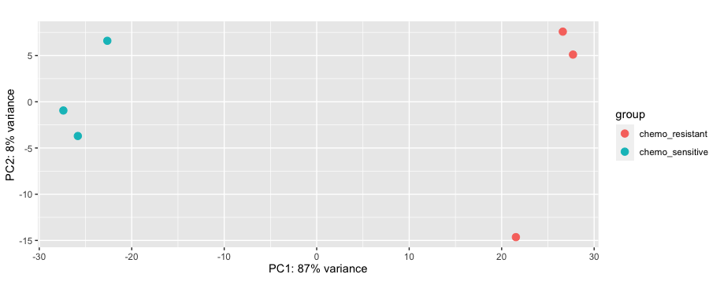
6. Unsupervised clustering – PCA plot
Principal Component Analysis (PCA) plot summarises the data in 2D , plotting their first two principal components. Similar to hierarchical clustering this is useful for visualizing sample grouping in an unsupervised manner.
plotPCA(vsd, intgroup=c("group"))

Slide 15
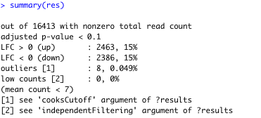
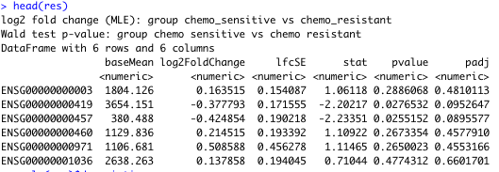
7. Getting the results of differential expression analysis
Run DE analysis (NOTE: Differential expression analysis operates on raw counts)
res <- results(dds, contrast=c("group", "chemo_sensitive", "chemo_resistant"))
View summary of results
summary(res)
head(res)
mcols(res)$description
Exporting results to a .csv file
write.csv(as.data.frame(res), file="DE_sensitiveVSresistant_results.csv")

Slide 16
7. What happens when running the DE analysis
Count data is modelled using the negative binomial distribution.
During the DE analysis DESEq2 :
estimates size factors
estimates dispersions
computes gene-wise dispersion estimates
finds mean-dispersion relationship
final dispersion estimates
fitting model (the Generalized Linear Model) and testing
*Dispersion is a measure of spread or variability in the data
IMPORTANT! DESeq2 doesn't actually use normalized counts, rather it uses the raw counts and models the normalization inside the Generalized Linear Model (GLM). These normalized counts are useful for downstream visualization of results but cannot be used as input to DESeq2 or any other tools that perform differential expression analysis which use the negative binomial model.

Slide 17
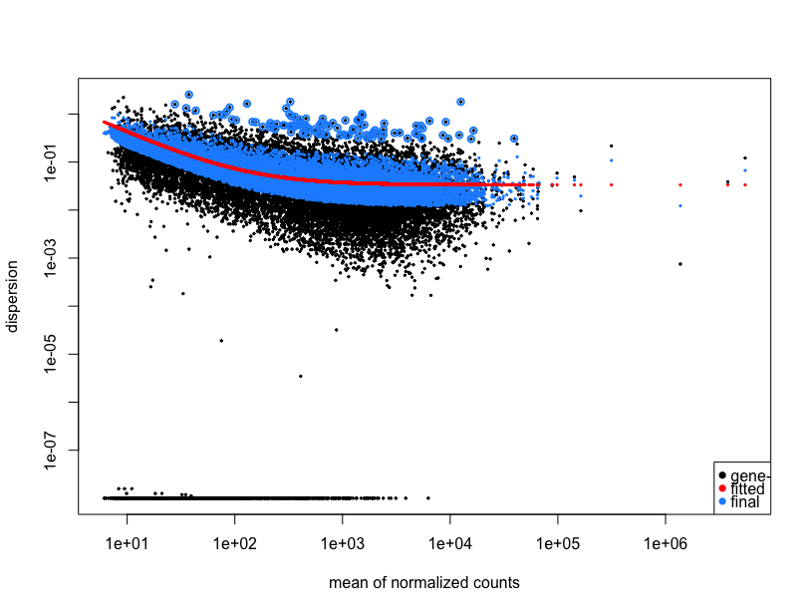
7. Plot Dispersion Estimates
Plotting the dispersion estimates is a useful diagnostic to observe how well the data has been captured by the model. Our data produced the typical shape of the dispersion plot, showing the final estimates shrunk from the gene-wise estimates towards the fitted estimates. Some gene-wise estimates are flagged as outliers and not shrunk towards the fitted value.
plotDispEsts(dds)

Slide 18
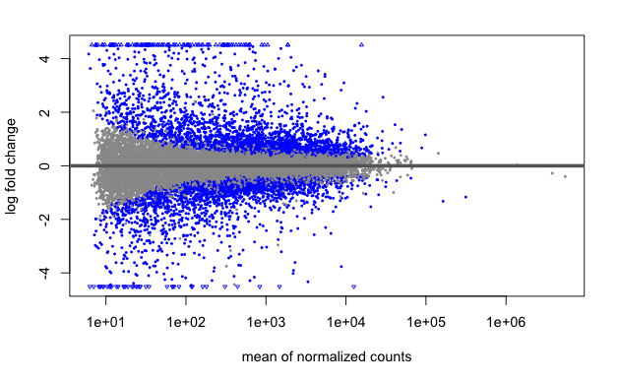
8. Graphical Visualizations of the DE genes – MA plot
plotMA shows the log2 fold changes of the genes (each dot is a gene) over the mean of normalized counts for all samples in our data.
plotMA(res)

Slide 19
8. Graphical Visualizations of the DE genes – MA plot
plotMA shows the log2 fold changes of the genes (each dot is a gene) over the mean of normalized counts for all samples in our data.
plotMA(res)
Genes upregulated in sensitive compared to resistant
Genes downregulated in sensitive compared to resistant

Slide 20
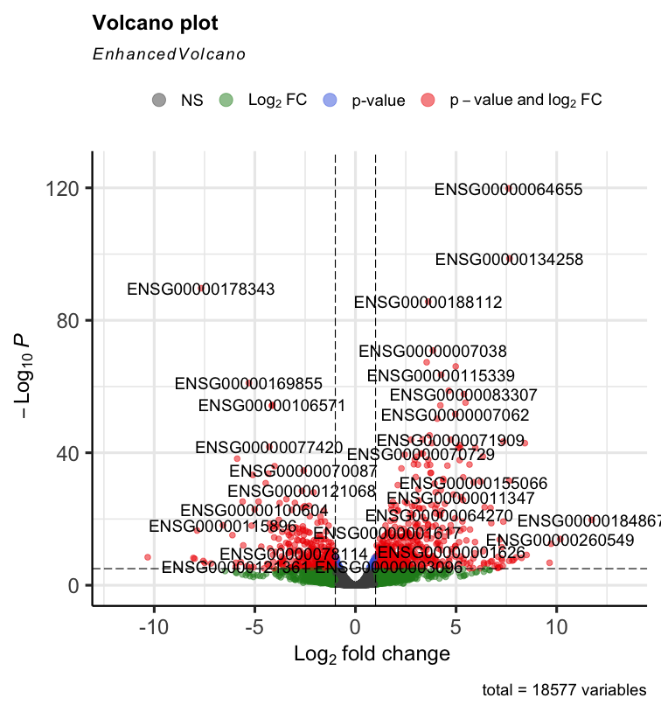
8. Graphical Visualizations of the DE genes – Volcano plot
In a volcano plot we can visualize the Log2Fold changes of all genes (again each dot represents a gene) plotted against the -Log10 Adjusted pvalue. In red are genes with padj < 0.05)
BiocManager::install('EnhancedVolcano')
library(EnhancedVolcano, quite = TRUE)
EnhancedVolcano(res,
lab = rownames(res),
x = 'log2FoldChange',
y = ‘padj')

Slide 21
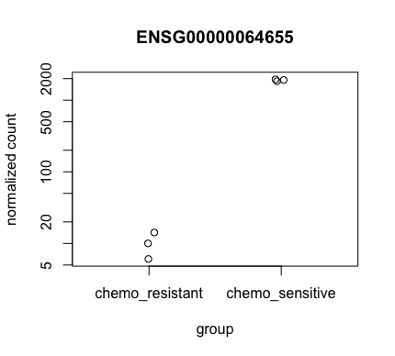
8. Graphical Visualizations of the DE genes – CountsPlot
It is also useful to examine the counts of reads for a single gene across the groups. plotCounts, produces a simple plot of the normalizes counts grouped by our sample groups. We can specify which gene to plot, here we are specifying to plot the gene which had the smallest adjusted p value from the results table.
plotCounts(dds, gene=which.min(res$padj), intgroup="group")

Slide 22
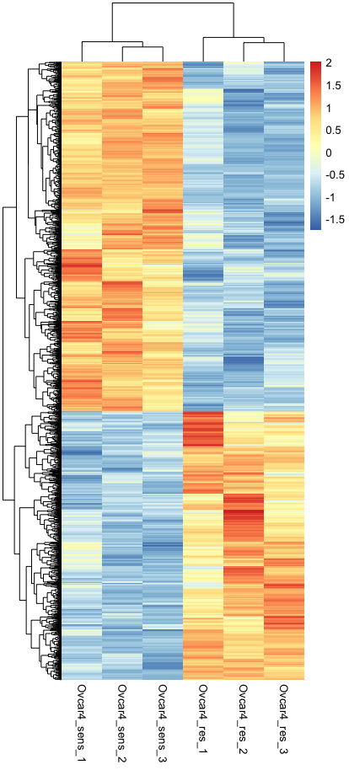
8. Graphical Visualizations of the DE genes – Heatmap
We can also visualize the differentially expressed genes using a heatmap. We are subseting the DE genes with padj < 0.05 and log2FC > |1| i.e. at least two-fold change in expression. The heatmap is illustrating normalized gene expression, which has been scaled by raw, across the differentially expressed genes in our samples. Columns correspond to samples and rows correspond to genes. Columns and also rows have been clustered by hierarchical clustering (dendrogram).
install.packages(“pheatmap”)
library(pheatmap)
de.sign <- subset(res, padj < 0.05 & abs(log2FoldChange) >1 )
de.sign.genes <- rownames(de.sign)
scale.dat <- t(scale(t(assay(vsd)[de.sign.genes,])))
pheatmap(scale.dat[de.sign.genes,], cluster_rows=TRUE, show_rownames=FALSE, cluster_cols=TRUE)

Slide 23
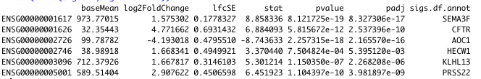
8. Annotation of output tables
It is useful to annotate our differential analysis results tables with Gene Symbols. We can do that using R package AnnotationDbi as shown below.
BiocManager::install('AnnotationDbi')
library(AnnotationDbi)
library(org.Hs.eg.db)
res.df <- as.data.frame(res)
res.annot <- mapIds(org.Hs.eg.db, keys = rownames(res.df), keytype = "ENSEMBL", column = "SYMBOL")
res.df.annot <- cbind(res.df,gene.symbol = res.annot) #binding the annotations to the sign.df
head(res.df.annot)
write.csv(res.df.annot, file = "/Users/maniat01/Documents/MSc_GCDS/RNASeq_practical/DE_sensitiveVSresistant_results_wGeneSymbol.csv")

Slide 24
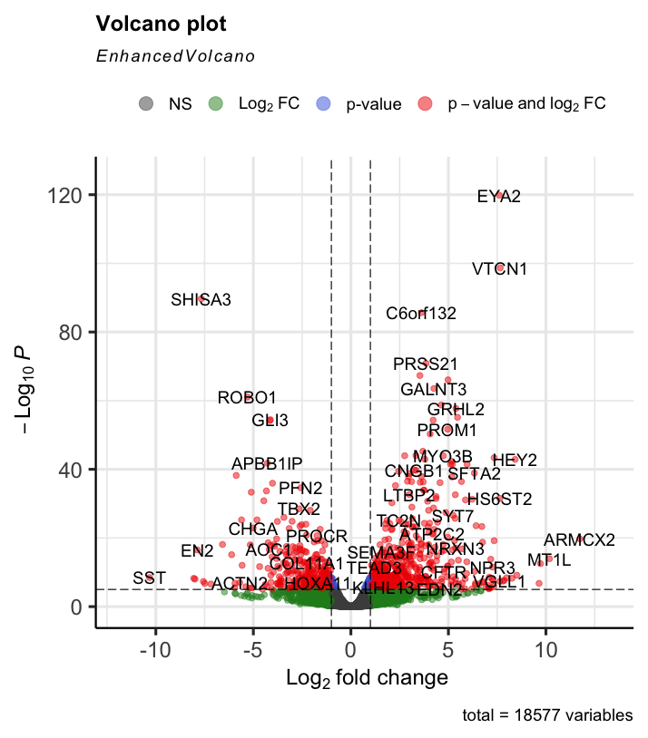
8. Replot the Volcano using Gene Symbols
Now that we have annotated the DE results with Gene Symbols lets re-graph the volcano plot labeling the points with Gene Symbols instead of Ensembl IDs.
EnhancedVolcano(sigs.df.annot,
lab = sigs.df.annot$gene.symbol,
x = 'log2FoldChange',
y = 'padj')
Can you interpret this plot? What does it mean if a gene is coloured red and is on the right hand side of the volcano?

Slide 25
References
Love MI, Huber W, Anders S (2014). “Moderated estimation of fold change and dispersion for RNA-seq data with DESeq2.” Genome Biology, 15, 550. doi: 10.1186/s13059-014-0550-8.
  https://bioconductor.org/packages/release/bioc/vignettes/DESeq2/inst/doc/DESeq2.html
Blighe K, Rana S, Lewis M (2022). EnhancedVolcano: Publication-ready volcano plots with enhanced colouring and labeling. R package version 1.16.0, https://github.com/kevinblighe/EnhancedVolcano.
  https://bioconductor.org/packages/devel/bioc/vignettes/EnhancedVolcano/inst/doc/EnhancedVolcano.html
Although on this practical we haven’t used EdgeR, ie. another popular DE analysis tool, be aware of it and look up in the future if needed, contains a lot of background information for experimental designs and DE analysis. https://bioconductor.org/packages/release/bioc/vignettes/edgeR/inst/doc/edgeRUsersGuide.pdf
From Harvard Chan Bioinformatics Core https://github.com/hbctraining/DGE_workshop/tree/master/lessons

